Slide 1

Stock Market Close Price Prediction
By:-
Hardik saxena (be/25027/17)
Deepanshu Arora (bTEch/25018/18)

Slide 2
Introduction
Ability to predict direction of stock/index price accurately is crucial for market dealers or investors to maximize their profits.
Machine Learning techniques have been successfully shown to generate high forecasting accuracy of stock price movement.
Web is rich textual information resource such as financial news even that is unmanageable to one. But one can use this abundance textual information to get datasets of various companies.

Slide 3
Goal
This project proposes a method for the prediction of stock market closing price.
It is an attempt to determine whether the NSE market news in combination with the historical quotes can efficiently help in the calculation of the NSE closing index for a given trading day.

Slide 4
Understanding the Problem Statement
Broadly, stock market analysis is divided into two parts – Fundamental Analysis and Technical Analysis.
Fundamental Analysis involves analyzing the company’s future profitability on the basis of its current business environment and financial performance.
Technical Analysis, on the other hand, includes reading the charts and using statistical figures to identify the trends in the stock market.
As you might have guessed, our focus will be on the technical analysis part.

Slide 5
I have used the data for ‘Tata Consultancy Services Share’. We will first load the dataset and define the target variable for the problem.
There are multiple variables in the dataset – date, open, high, low, last, close, total trade quantity, and turnover.
The columns Open and Close represent the starting and final price at which the stock is traded on a particular day.
High, Low and Last represent the maximum, minimum, and last price of the share for the day.
Total Trade Quantity is the number of shares bought or sold in the day and Turnover (Lacs) is the turnover of the particular company on a given date.
The profit or loss calculation is usually determined by the closing price of a stock for the day, hence we will consider the closing price as the target variable

Slide 6
SIMPLE MOVING AVERAGE(SMA)
‘Average’ is easily one of the most common things we use in our day-to-day lives .So this is a good starting point to use on our dataset for making predictions.
The predicted closing price for each day will be the average of a set of previously observed values. Instead of using the simple average, we will be using the moving average technique which uses the latest set of values for each prediction. In other words, for each subsequent step, the predicted values are taken into consideration while removing the oldest observed value from the set. Here is a simple figure that will help you understand this with more clarity.

Slide 7
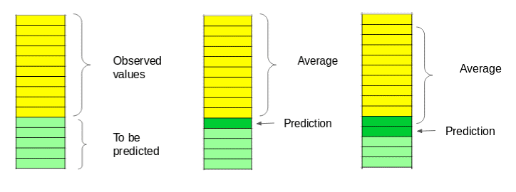

Slide 8
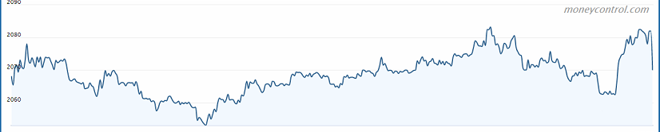
DAILY MOVEMENT CHART

Slide 9
Machine Learning Techniques…
We have used two models of Machine learning for the prediction-
Linear Regression
Support Vector Machine

Slide 10
Approach………..
With the use of Quandle library we would extract our data into csv file and with the help of Pandas library we would read that csv file
Now since we don’t have enough features we would generate some with the help of date column like ‘Year’, ‘Month’, ‘Week’, ‘Day’, ‘Dayofweek’, ‘Dayofyear’, ‘Is_month_end’, ‘Is_month_start’, ‘Is_quarter_end’, ‘Is_quarter_start’, ‘Is_year_end’, and ‘Is_year_start’.
Now for more accurate prediction , we would add our own set of features that we believe would be relevant for the predictions. For instance, my hypothesis is that the first and last days of the week could potentially affect the closing price of the stock far more than the other days. So I have created a feature that identifies whether a given day is Monday/Friday or Tuesday/Wednesday/Thursday.

Slide 11

Linear Regression……….
It is the most basic machine learning algorithm that can be implemented on this data . The linear regression model returns an equation that determines the relationship between the independent variables and the dependent variable.
The equation of linear regression can be written as:
But for this problem statement , we do not have to a set of independent variables. We have only the dates instead. Let us use the date column to extract features like – day, month, year, mon/fri etc. and then fit a linear regression model
.

Slide 12
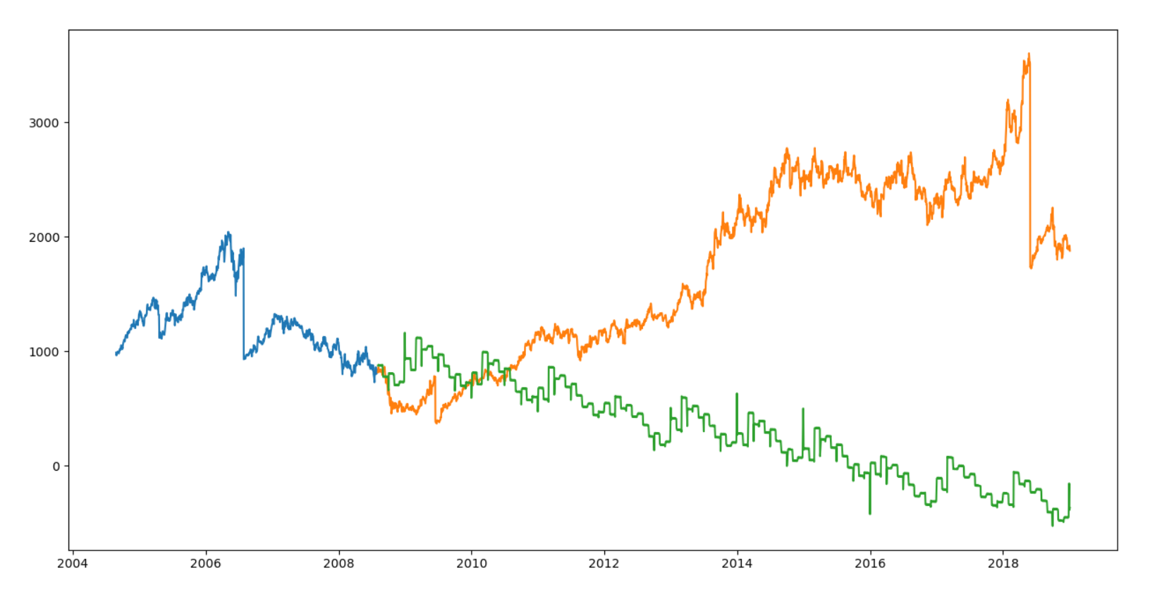
Prediction Chart………
RMS: 1826.2993582433187

Slide 13

Support Vector Regression
A Support Vector Regression (SVR) is a type of Support Vector Machine, and is a type of supervised learning algorithm that analyzes data for regression analysis. The model produced by SVR depends only on a subset of the training data, because the cost function for building the model ignores any training data close to the model prediction.
In this problem we will use radial basic function (rbf) kernel . This function is one of the most popular kernel functions and is defined as:
The advantage of this function is that it can handle diverse input sets.
where δ is known as the bandwidth of the kernel function

Slide 14
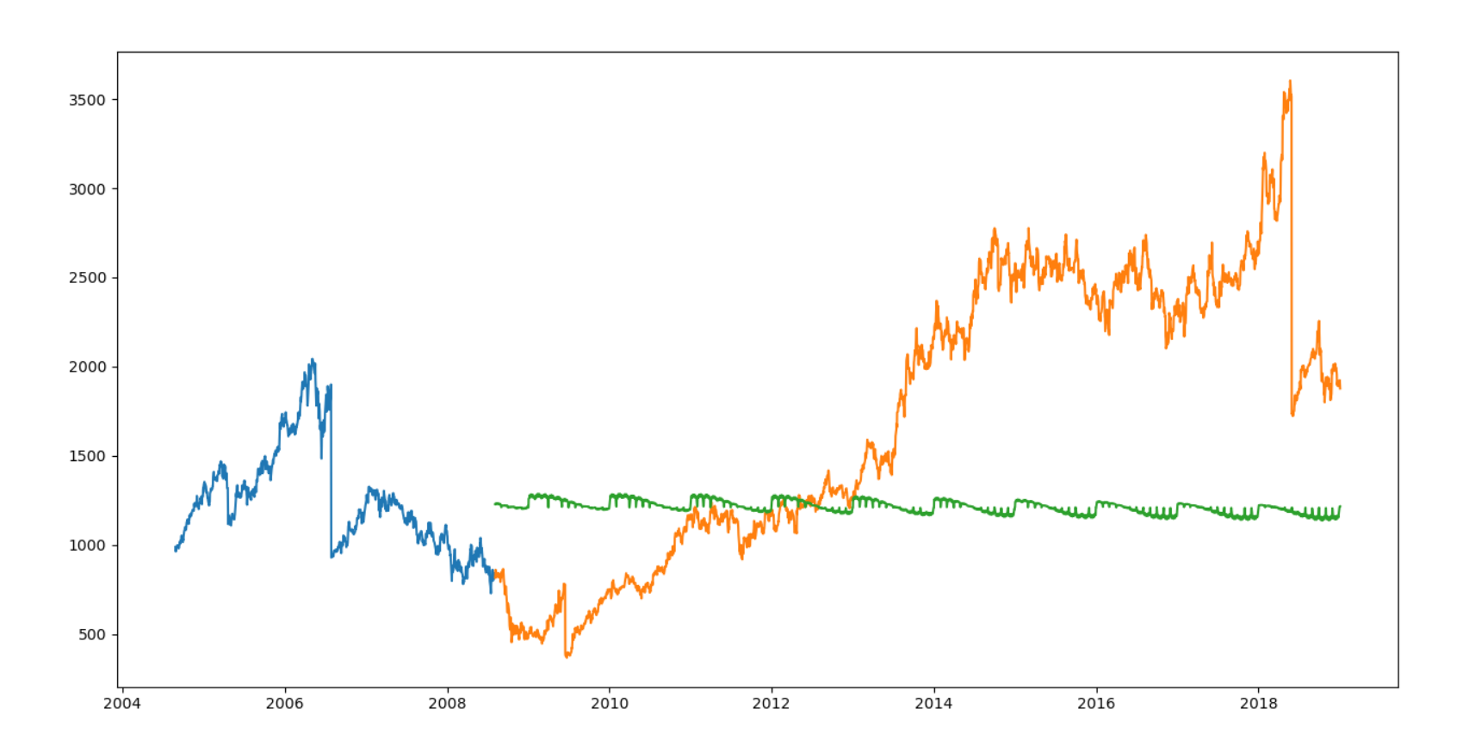
Plotting graph…………
RMS: 948.3108327967581

Slide 15
Inference………
Linear regression is a simple technique and quite easy to interpret, but there are a few obvious disadvantages. One problem in using regression algorithms is that the model overfits to the date and month column. Instead of taking into account the previous values from the point of prediction, the model will consider the value from the same date a month ago, or the same date/month a year ago.
SVR is a comparatively high technique and in this we have use ‘rbf’ kernel That means that classification is based heavily on the most similar training examples and takes advantage of patterns in the data. This is exactly what is needed for time-series data such as stock prices that display trends.
There for between these two techniques SVC model is better and will give more accurate result

Slide 16
THANK YOU

